Slide 1
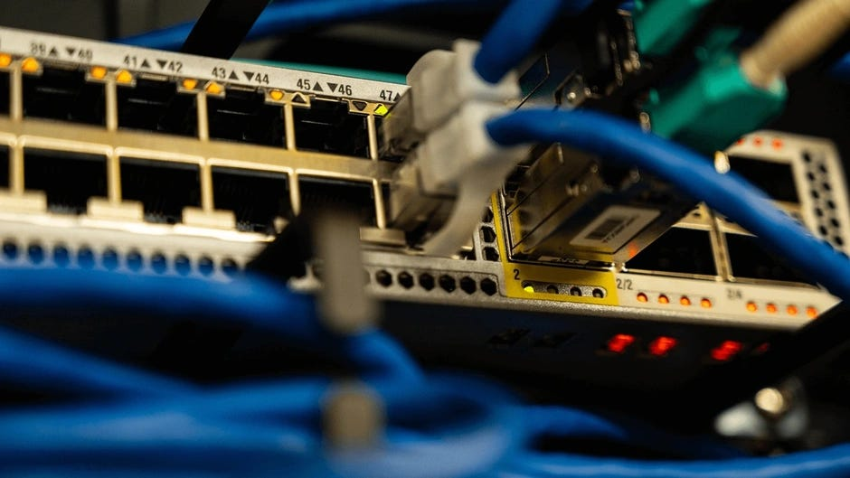
Introduction to Computer Networks (CSCI463) Lab_5 TCP & UDP
Under Supervisors :
Eng. Lamiaa Omar
Eng. Ismail Abu-Krisha

Slide 2

Outline
TCP
UDP

Slide 3
TCP (Transmission Control Protocol)
Purpose and Functionality
TCP is connection-oriented, meaning it establishes a reliable connection between sender and receiver before transmitting data. It provides error checking, ensures all data packets are received in the correct order, and retransmits lost packets.
Reliability
Reliable, as it uses mechanisms like sequence numbers, acknowledgments, and retransmissions to ensure data is received correctly and in order.
Data Transfer Speed
Slower due to the overhead of establishing a connection, error checking, and managing acknowledgments. Suitable for scenarios where accuracy is more critical than speed.
Header Size
The header size is larger, typically 20 bytes, due to additional fields for managing connections and reliability (e.g., sequence numbers, acknowledgment numbers, and flow control).

Slide 4
TCP (Transmission Control Protocol)
Use Cases
Web browsing (HTTP, HTTPS)
Email (SMTP, IMAP)
File transfers (FTP)
Remote access (SSH, Telnet)
Flow Control and Congestion Control
Has built-in flow control and congestion control mechanisms, which help to prevent network congestion and adjust the transmission rate based on network conditions.
Error Checking
Includes extensive error-checking mechanisms, allowing it to detect and retransmit lost or corrupted packets.
Order of Data Transmission
Ensures data arrives in order, using sequence numbers and reordering any out-of-order packets before passing data to the application.

Slide 5
TCP (Transmission Control Protocol)
Connection
Connection-oriented, requiring a three-way handshake (SYN, SYN-ACK, ACK) to establish a connection and a four-step process to close it.

Slide 6
TCP (Transmission Control Protocol)
Key TCP Mechanisms
Three-Way Handshake: Ensures reliable connection establishment.
Sequence Numbers: Orders and identifies packets for accurate data reassembly.
Acknowledgments and Retransmission: Confirms delivery and resends lost packets.
Flow and Congestion Control: Manages transmission rates to prevent overloading.
Four-Way Handshake: Provides an orderly connection closure.

Slide 7
UDP (User Datagram Protocol)
Purpose and Functionality
UDP is connectionless, meaning it sends data without establishing a prior connection. It’s faster but doesn’t guarantee the delivery or order of packets, making it suitable for real-time applications where speed is prioritized over reliability.
Reliability
Unreliable; it sends packets without tracking their delivery or order, which may result in lost or unordered data.
Data Transfer Speed
Faster, with lower overhead since it doesn’t require acknowledgment of receipt or connection setup. Ideal for applications where quick transmission is needed.
Header Size
Smaller header, typically 8 bytes, with minimal fields (source port, destination port, length, and checksum), making it more lightweight and faster.

Slide 8
UDP (User Datagram Protocol)
Use Cases
Online gaming
Video streaming (YouTube, Netflix)
Voice-over-IP (VoIP) calls
DNS queries and DHCP
Flow Control and Congestion Control
Lacks flow and congestion control, meaning it doesn’t respond to network congestion and will continue to send packets regardless of network conditions.
Error Checking
Only performs basic error-checking using checksums, which may detect errors but won’t retransmit erroneous packets. It’s “best-effort,” so errors aren’t corrected.
Order of Data Transmission
Doesn’t guarantee packet order, so packets may arrive out of sequence, especially in high-speed, real-time applications.

Slide 9
UDP (User Datagram Protocol)
Connection
Connectionless, meaning no setup or teardown process is involved. Packets are sent independently.

Slide 10
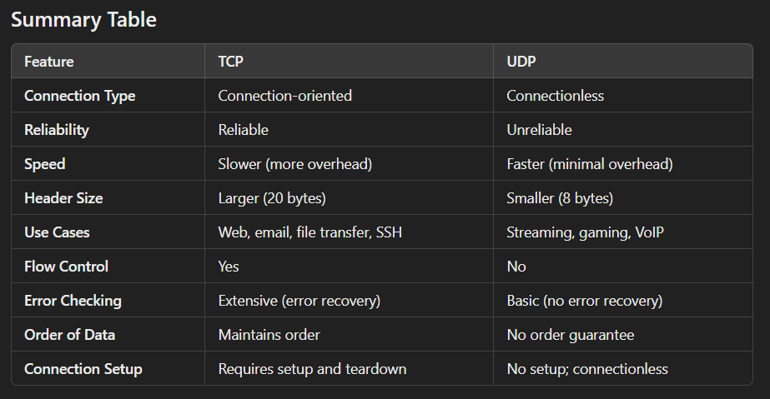
Summary

Slide 11
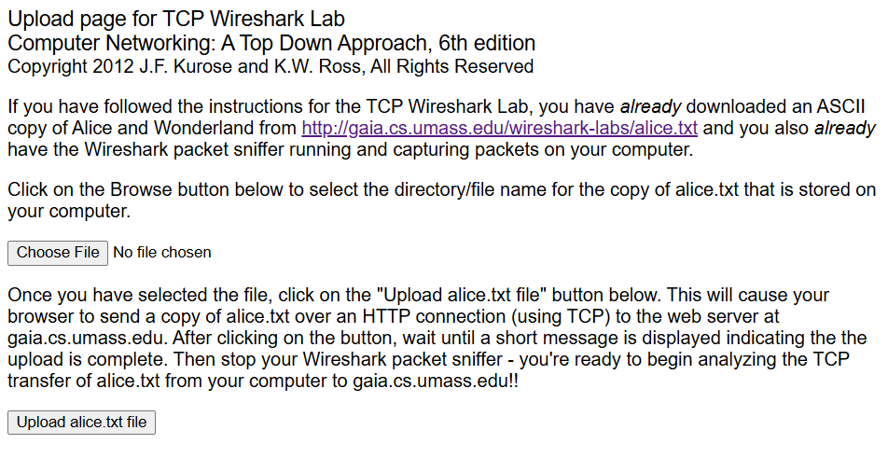
Lab Task
Start up your web browser. Go the http://gaia.cs.umass.edu/wireshark-labs/alice.txt and retrieve an ASCII copy of Alice in Wonderland. Store this file somewhere on your computer.
Next go to http://gaia.cs.umass.edu/wireshark-labs/TCP-wireshark-file1.html.
You should see a screen that looks like:

Slide 12
Lab Task
Use the Browse button in this form to enter the name of the file (full path name) on your computer containing Alice in Wonderland (or do so manually). Don’t yet press the “Upload alice.txt file” button.
Now start up Wireshark and begin packet capture (Capture->Start) and then press OK on the Wireshark Packet Capture Options screen.
Returning to your browser, press the “Upload alice.txt file” button to upload the file to the gaia.cs.umass.edu server. Once the file has been uploaded, a short congratulations message will be displayed in your browser window.
Stop Wireshark packet capture.
Filter the packets displayed in the Wireshark window by entering “tcp” (lowercase, no quotes, and don’t forget to press return after entering!)

Slide 13
Lab Task
What is the sequence number of the TCP SYN segment that is used to initiate the TCP connection between the client computer and gaia.cs.umass.edu? What is it in the segment that identifies the segment as a SYN segment?
What is the sequence number of the SYNACK segment sent by gaia.cs.umass.edu to the client computer in reply to the SYN? What is the value of the Acknowledgement field in the SYNACK segment? How did gaia.cs.umass.edu determine that value? What is it in the segment that identifies the segment as a SYNACK segment?
What is the sequence number of the TCP segment containing the HTTP POST command? Note that in order to find the POST command, you’ll need to dig into the packet content field at the bottom of the Wireshark window, looking for a segment with a “POST” within its DATA field.

Slide 14
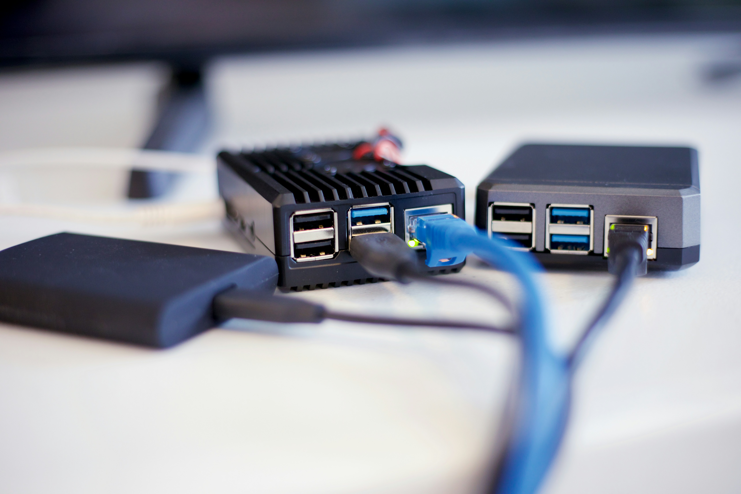
Thank You !

